Slide 1

BASIC WRITING
Instructor: Lê Tấn Trung
“Either write something worth reading or do something worth writing."
– Benjamin Franklin -

Slide 2
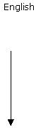

Recap on the previous session
Syllabus introduction
Linearity
Dependency
Linking Scope
Economy of language
Vocabulary

Slide 3
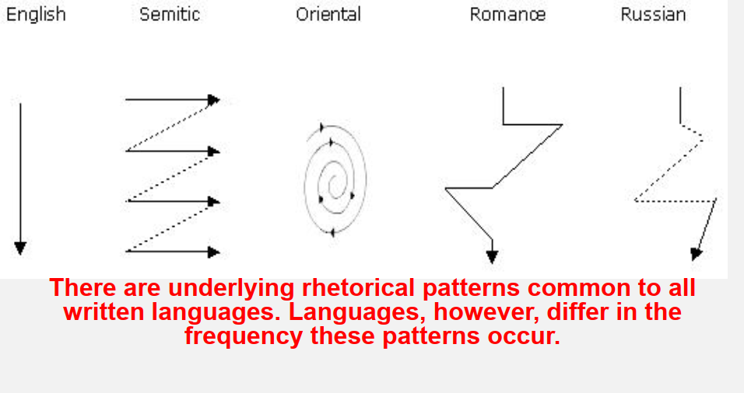
Kaplan’s paper
previously

Slide 4
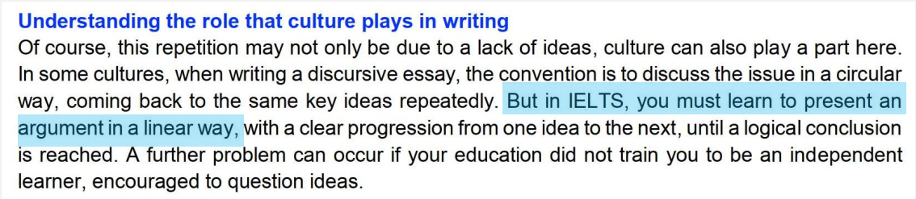
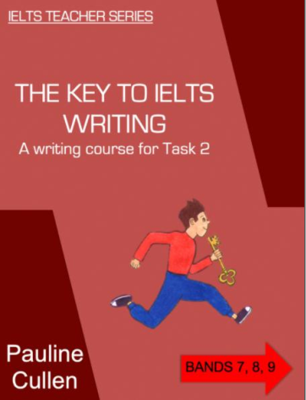
LINEARITY
previously
as discussed in popular writing textbooks: vague at best

Slide 5
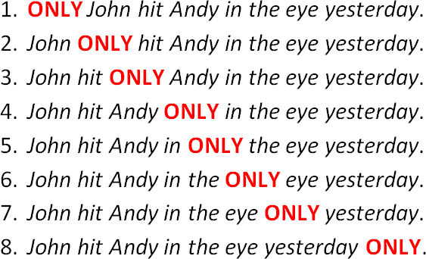
Previously – linking scope
[Nobody else hit Andy]
[John did nothing else to Andy]
[John hit nobody else in the eye]
[and not outside the eye]
[and not other body parts]
[Andy has only one eye]
[and not some other day]
[he didn’t want to do it any other day]

Slide 6
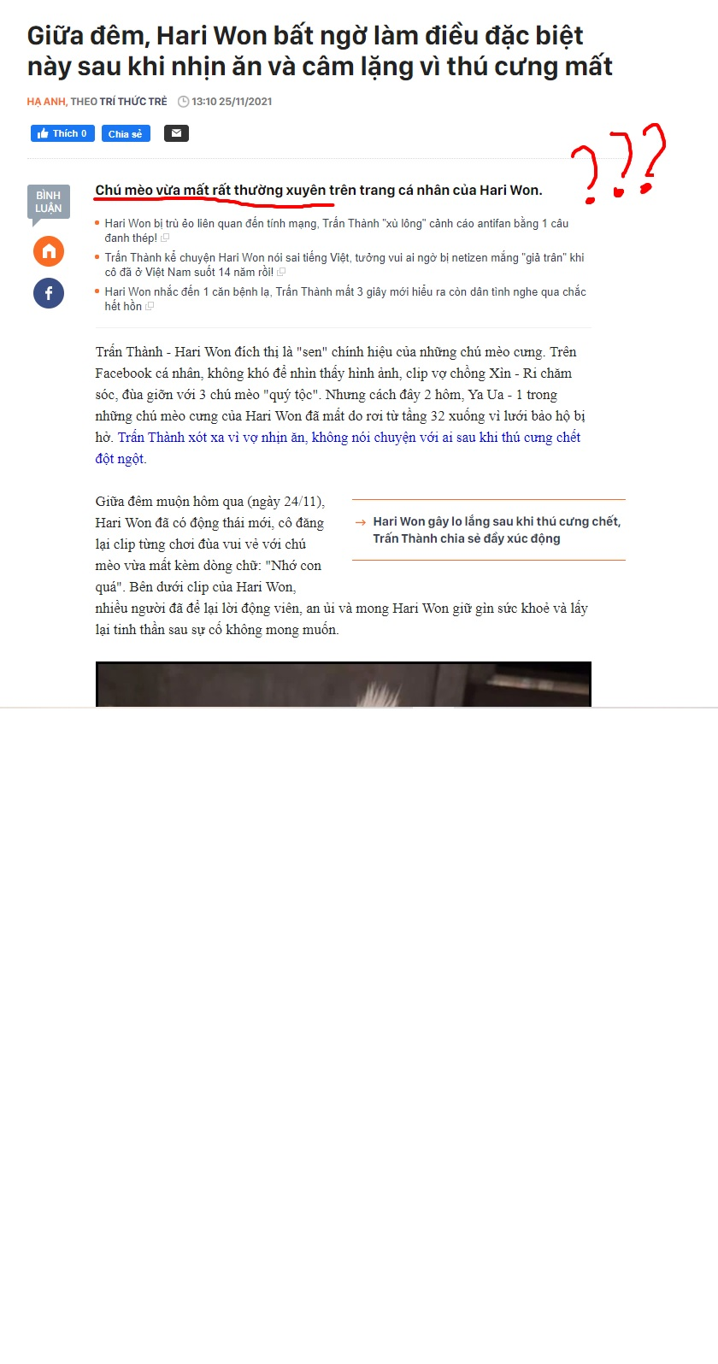

Slide 7
WARM-UP: LINKING REVISIT
• For sale: an antique desk suitable for lady with thick legs and large drawers. • Tuesday is Pensioner's Day - buy one, get one free! • Critics question self-inspection of cows during the mad cow outbreak. • Lost: small poodle. Reward. Neutered. Like one of the family. • We do not tear your clothing with machinery. We do it carefully by hand. • Will you please send someone to mend our cracked sidewalk? Yesterday my wife tripped on it and is now pregnant.

Slide 8
WARM-UP: LINKING REVISIT - key
• For sale: an antique desk with thick legs and large drawers suitable for lady. • Tuesday is Pensioner's Day – every item is on sale - buy one, get one free! • Critics question the inspection of cows’ owners during the mad cow outbreak. • Lost: small neutered poodle. Like one of the family. Reward. • We do not tear your clothing with machinery. We wash it carefully by hand. • Will you please send someone to mend our cracked sidewalk? Yesterday my pregnant wife who is now pregnant tripped on it and.
Will you please send someone to mend our cracked sidewalk? Yesterday my wife tripped on it and she is now pregnant.

Slide 9
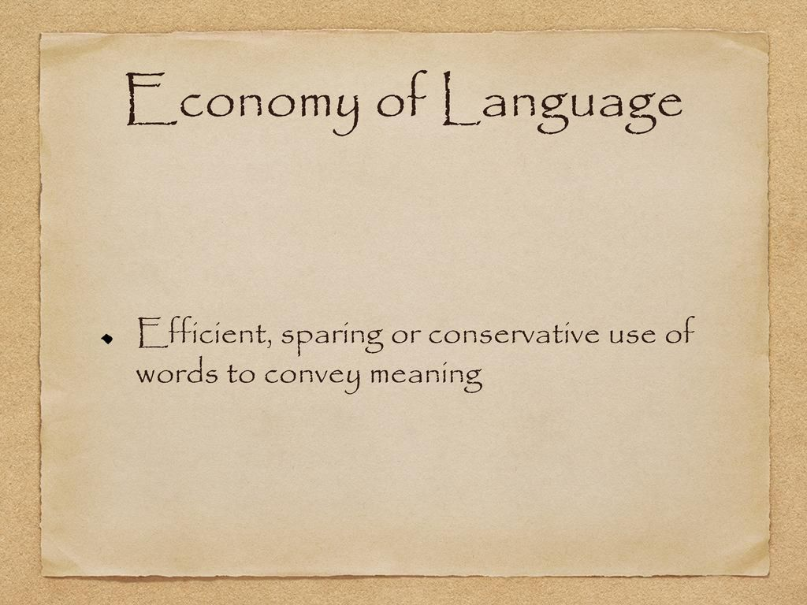
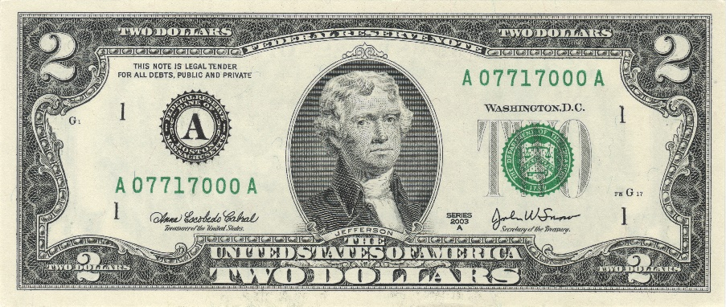
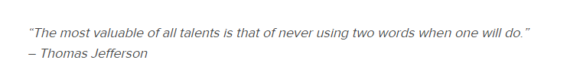
Previously

Slide 10
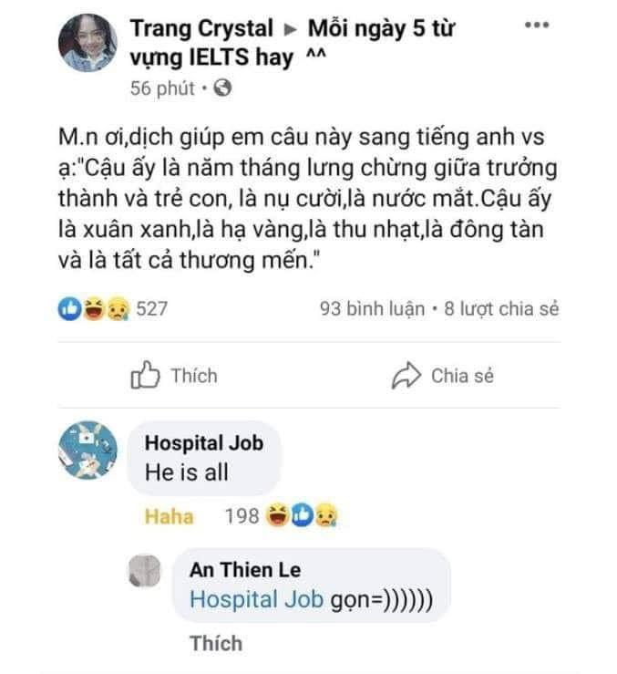
Previously – economy of language

Slide 11
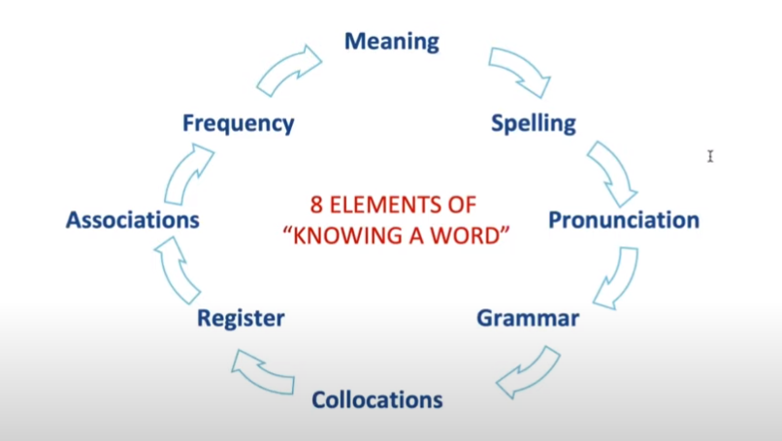
Previously – vocabulary recalling
Meaning : nghĩa
Spelling: đánh vần ( mặt chữ )
Pronunciation : phát âm
Grammar (adj, n , v )
Collocations ( words that often go with them )
Register ( ngữ vựng ) : is it formal or informal or neutral ?
Association : What words are related to this word?
Frequency : how often is the word used ?

Slide 12
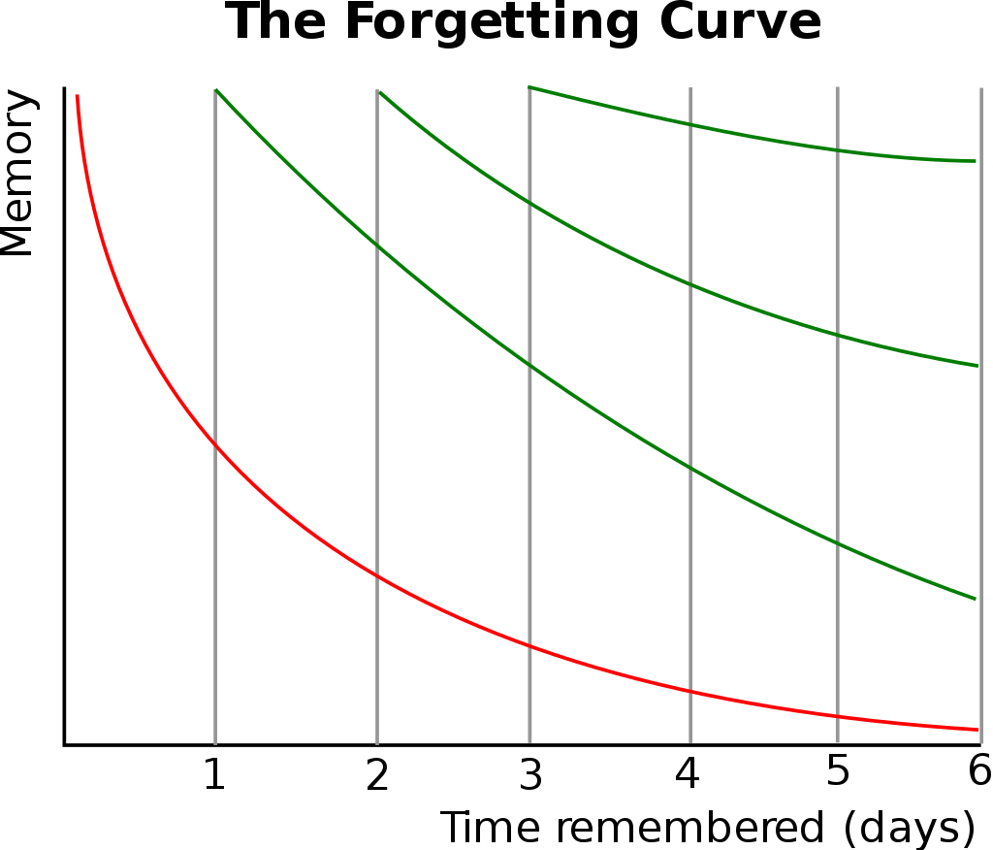
VOCABULARY RECALL

Slide 13
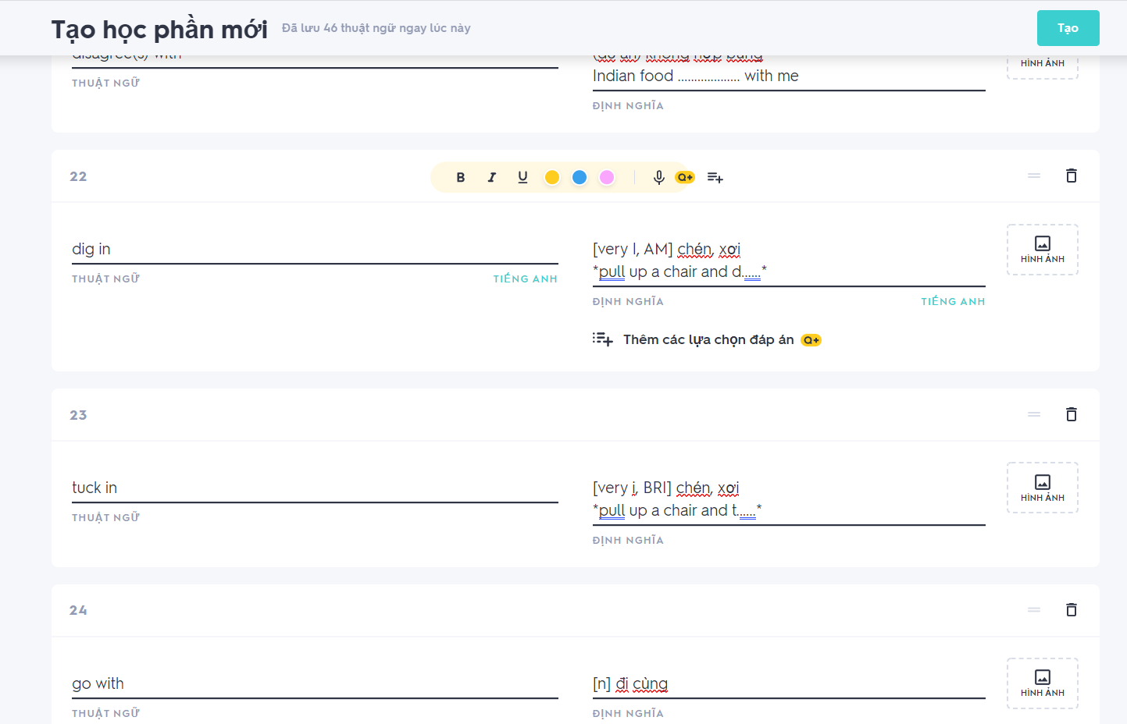
Use apps ( such as Quizlet) for vocab recalling

Slide 14
Session 2 – The sentence

Slide 15
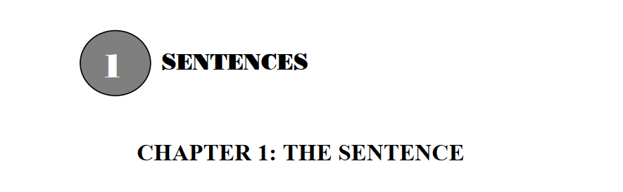
Chapter 1: The sentence

Slide 16

Finite verbs VS non-finite verbs
Sample clip from an Indian instructor

Slide 17
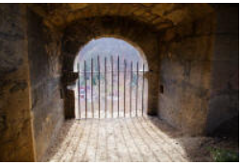
Finite verb forms
Finite verbs and verb phrases are clearly linked to definable subject
1. Tense
For example, by changing the ending or the central vowel as in:
come to came
arrive to arrived
2. Person
For example
by adding an -s for the 3rd person singular:
smoke to smokes

Slide 18

Non-finite verb forms
Non-finite verbs and verb phrases are not specifically tied to a subject and do not show tense or person. It can take 3 forms:
Infinitive form:
He wanted to find a solution.
2. Participle form:
He is looking for a solution.
3. the gerund form:
Looking for solutions is something he enjoys.

Slide 19
Non-finite verb functions
Non-finite verb forms function grammatically in five distinct ways:
Adjectives
It's a smoking gun
The window's broken
2. Nouns
I like playing cards in the evening
I hate waiting for buses
3. Infinitives (with and without to)
I came to help
I want to complain
She must help us
4. Present participles
Falling over, John hurt his ankle
I was living in London at that time
5. Past participles
Disappointed, he left early
The car was repaired

Slide 20
Exercise application
Finite Verbs
Non-finite Verbs
2- Living in Rugby is much cheaper, though.
-> Living in Rugby is much cheaper, though.
3-Keith needs to work hard every day, earning to support his whole family.
-> Keith needs to work hard every day, earning(1) to support(2) his whole family.

Slide 21

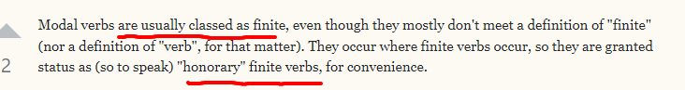
Food for thought
Are modal verbs finite or non-finite?
Some modals do inflect for tense (could, would)
Those that don't inflect do so for linguistic reasons, not grammatical reasons.
Modal verbs are only used as finite verbs, as the root of the sentence.
I think you like canning swim?

Slide 22
PHRASES AND CLAUSES
PHRASES: groups of words containing non-finite verbs
Eg:
1-Looking at the board, she knew that she was on the wrong way.
2-This is a long novel written by a very famous writer.

Slide 23
EA – identifying phrases / clauses
3- When it rains, I usually go to the office by bus.
-> When it rains, I usually go to the office by bus.
4- Henry did the work as it ought to be done.
-> Henry did the work as it ought to be done.
6-I received my wages yesterday, so that I can now pay what I owe you.
-> I received my wages yesterday, so that I can now pay what I owe you.
7-Walking through the park, we saw a lovely show of daffodils.
->Walking through the park, we saw a lovely show of daffodils.

Slide 24
Dependent clauses & independent clauses

Slide 25
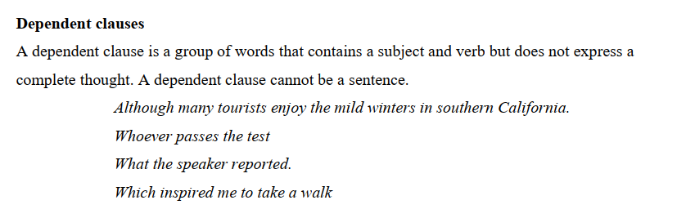
Dependent clause

Slide 26
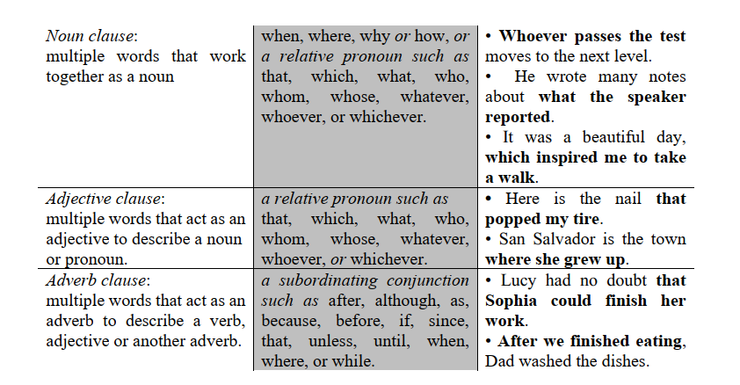
Dependent clause

Slide 27
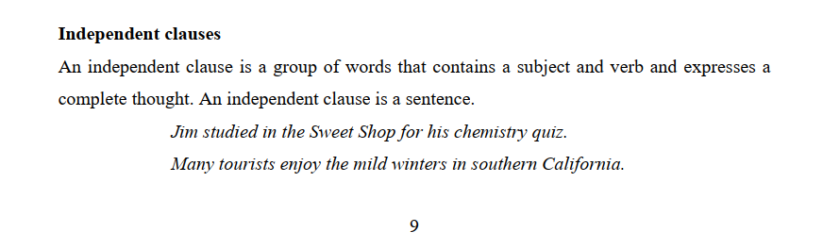
Independent clause

Slide 28
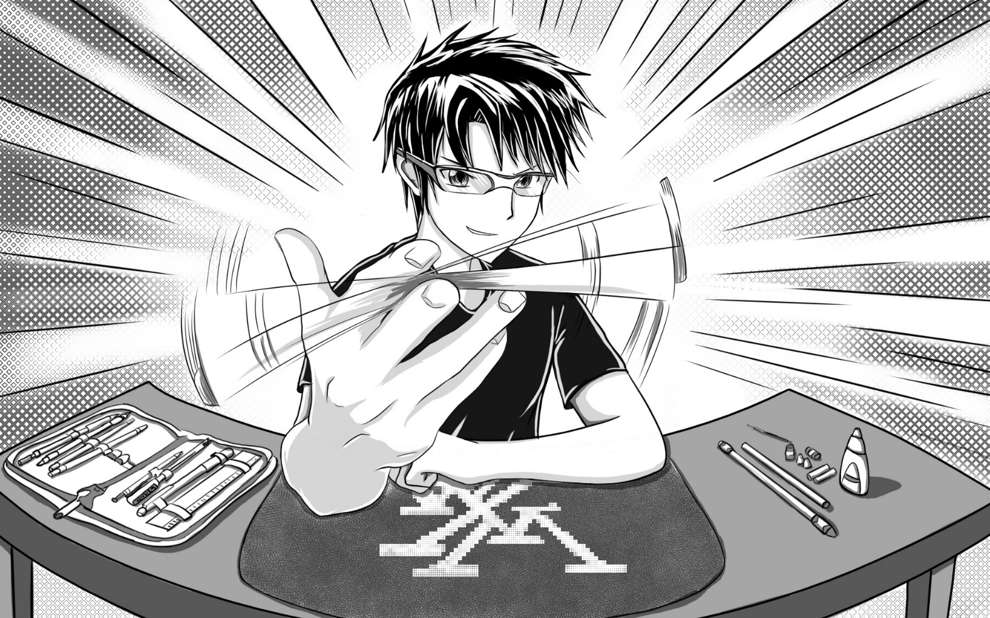
Skill practice
1.3.2. pg 10

Slide 29
Chapter 2: Types of sentences

Slide 30
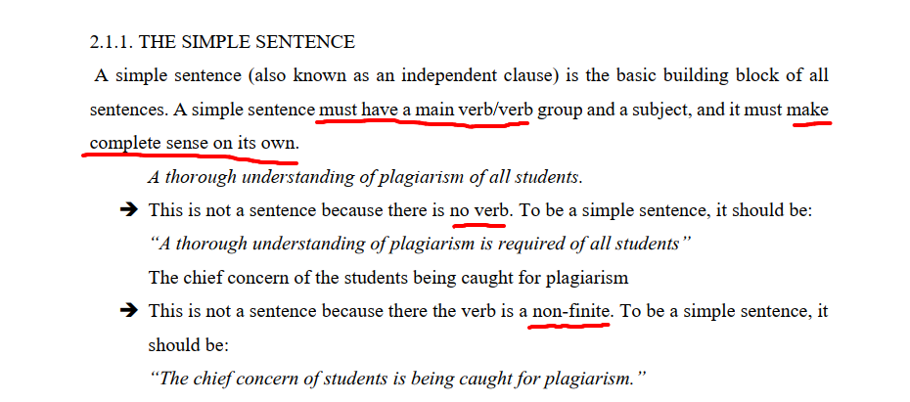
THE SIMPLE SENTENCE

Slide 31
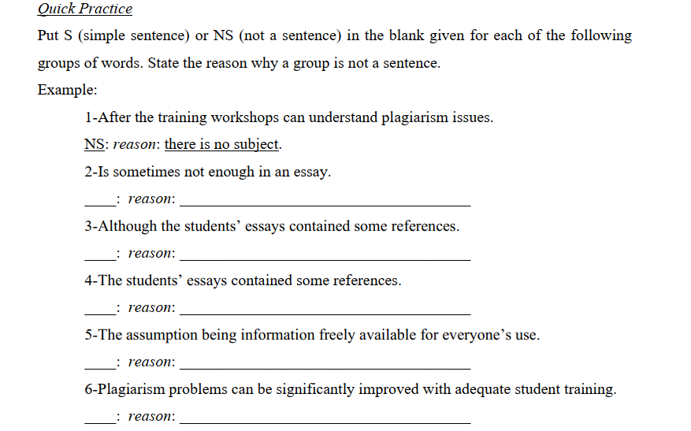
THE SIMPLE SENTENCE

Slide 32
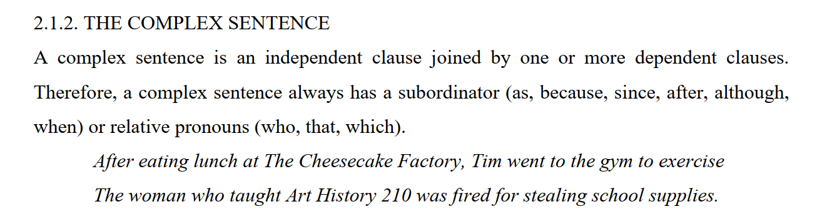
THE COMPLEX SENTENCE

Slide 33
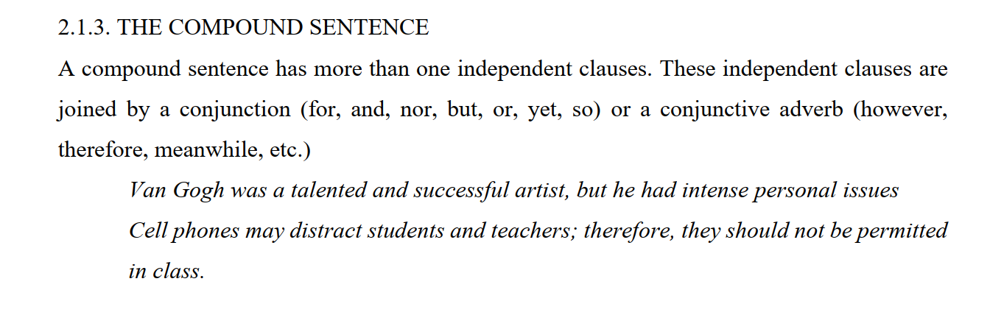
THE COMPOUND SENTENCE

Slide 34
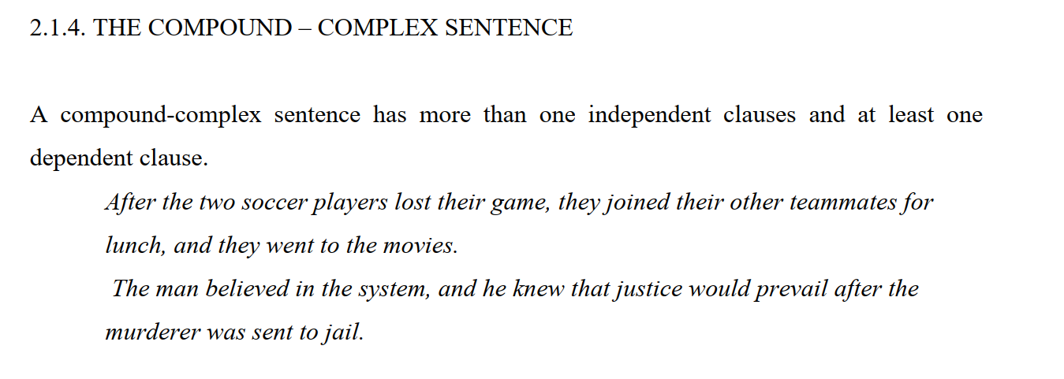
THE COMPOUND COMPLEX SENTENCE

Slide 35
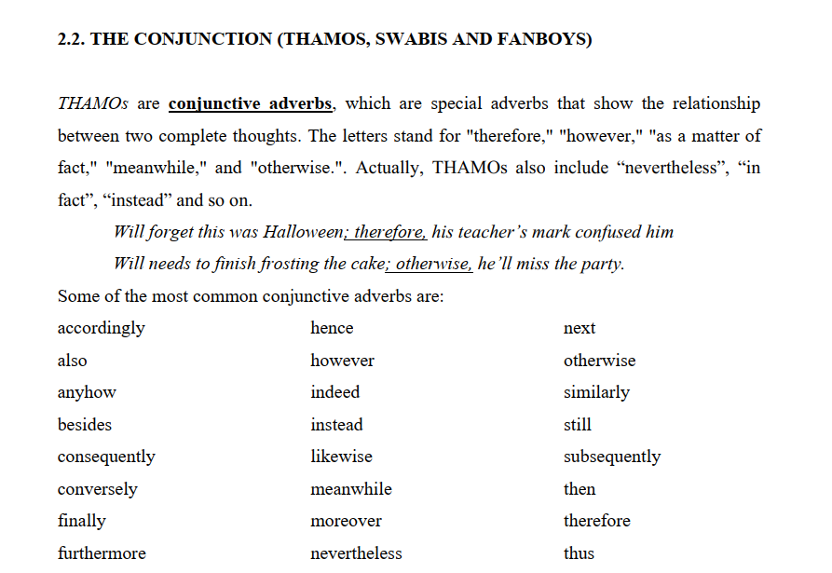
CONJUNCTIVE ADVERBS

Slide 36
Conjunctive adverbs
Function | Conjunctive Adverb | Example
Addition | also, furthermore, moreover, besides | Alicia was late for class and stuck in traffic; furthermore, her shoe heel had broken and she had forgotten her lunch.
Comparison | similarly, likewise | Recycling aluminum cans is beneficial to the environment; similarly, reusing plastic bags and switching off lights reduces waste.
Contrast | instead, however, conversely | Most people do not walk to work; instead, they drive or take public transit.
Emphasis | namely, certainly, indeed | The Siberian tiger is a rare creature; indeed, there are fewer than five hundred left in the wild.
Cause and Effect | accordingly, consequently, hence, thus | I missed my train this morning; consequently, I was late for my meeting.
Time | finally, next, subsequently, then | Danzel crossed the barrier, jumped over the wall, and pushed through the hole in the fence; finally, he made it to the station.

Slide 37
Food for thought
For example VS for instance VS such as VS including VS namely VS like
E.g:
I have many hobbies like watching movies, listening to music,...
I have many hobbies such as watching movies, listening to music,...
I have many hobbies, for instance, watching movies, listening to music,...
I have many hobbies, for example, watching movies, listening to music,…
I have many hobbies including watching movies, listening to music,…
I have many hobbies, namely watching movies, listening to music,...

Slide 38
Food for thought
For example VS for instance VS such as VS including VS namely VS like
E.g:
I have many hobbies like watching movies, listening to music,... (I, awkward)
I have many hobbies such as watching movies, listening to music,... (N)
I have many hobbies, for instance watching movies, listening to music,... (N)
I have many hobbies, for example watching movies, listening to music,… (N)
I have many hobbies including watching movies, listening to music,… (N)
I have many hobbies, namely watching movies, listening to music,...
-> ( this should be an exhaustive list)

Slide 39
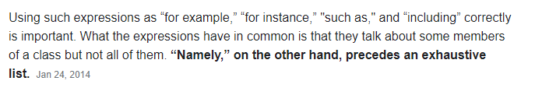
Food for thought
For example VS for instance VS such as VS including VS namely

Slide 40
Food for thought
Like VS such as
like implies comparison.
Such as is inclusive.
I like the new animation movies such as Ice Age and Rio. (I like Ice Age and Rio)
I do like some science classes such as physics and math. (Physics and math are included in the science classes that I like)
I have been to cities like Los Angeles.
(I may have not been to Los Angeles but may be another city like it; a city that is as busy, as popular, etc.)

Slide 41
Food for thought
Cannot use "like" in the following sentence.
I have been to some great cities in California such as Los Angeles and San Francisco.
(I have been to those two great cities in California.)
(It wouldn't make much sense to use "like" here since we are listing.)
Cannot use "such as" in the following sentence.
Captain America was another superhero movie like Spider-Man and Superman.
(A movie that is similar to the other two)
(Cannot use "such as" since we are making a comparison.)
Captain America was another superhero movie such as Spider-Man and...

Slide 42
Food for thought
In some cases, "like" and "such as" can be used interchangeably. (correct but with different meanings)
A man like Dr. Kimble will always be remembered.
(Men similar to Dr. Kimble; as successful, as popular or as extraordinary)
2. A man such as Dr. Kimble will always be remembered.
(This sentence puts emphasis particularly on Dr. Kimble.)
(Dr. Kimble will be remembered.)

Slide 43
Food for thought
Sample clip >>> namely

Slide 44
Food for thought
Also VS furthermore VS moreover VS besides
Also [slightly I]
Besides [N]
furthermore [F,A]
moreover [A]

Slide 45
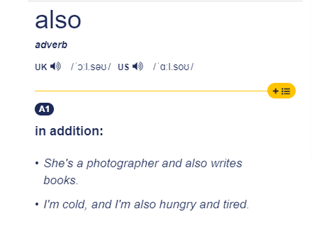
Also [slightly I]

Slide 46
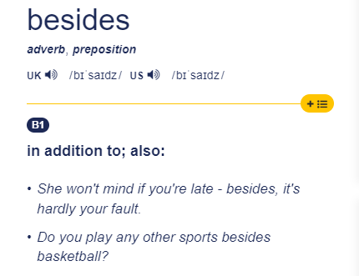
Besides [N]

Slide 47
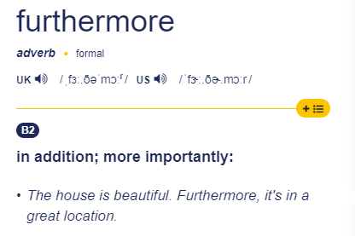
furthermore [F,A]

Slide 48
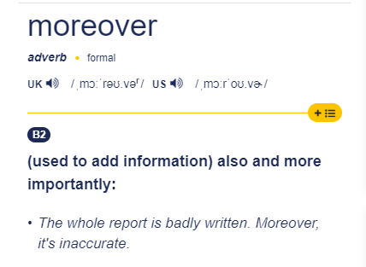
moreover [A]

Slide 49
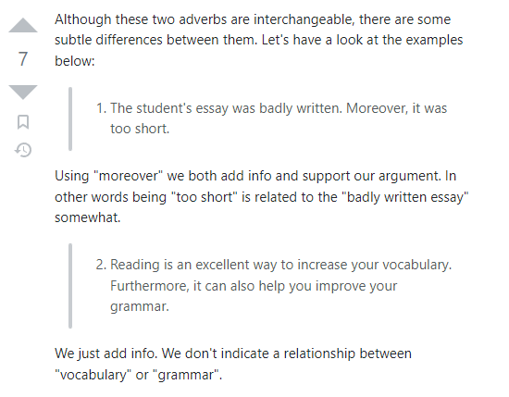
Furthermore VS Moreover

Slide 50
Conjunctive adverbs
Original sentences: Bridget wants to take part in the next Olympics. She trains every day.
Revised sentence: Bridget wants to take part in the next Olympics; therefore, she trains every day.

Slide 51
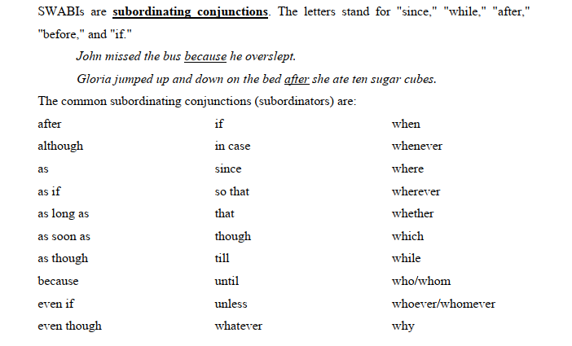
SUBORDINATING CONJUNCTIONS

Slide 52
Semantic Categories of Subordinating Conjunctions
Time
Concession
Comparison
Cause
Condition
Place

Slide 53
Subordinating Conjunctions
Time
After
As soon as
As long as
Before
Once
Still
Until
When
Whenever
While

Slide 54
Food for thought
As long as?
As soon as?
Sample clip

Slide 55
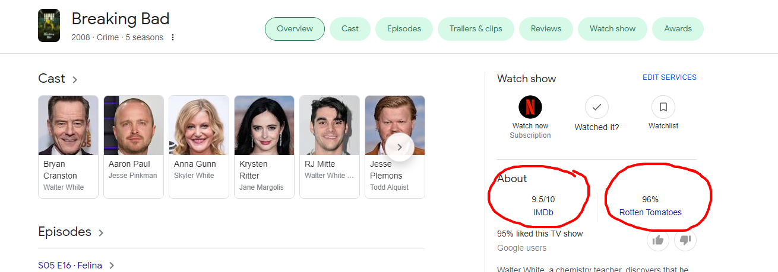
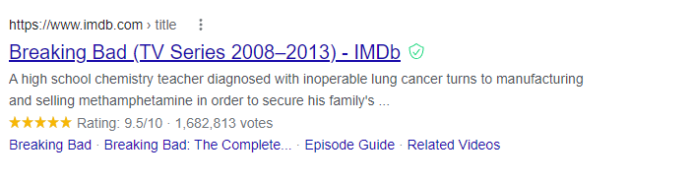
FYI

Slide 56
Subordinating Conjunctions
2. Concession
Although Sarah completed her report although she had to stay late to get it done.
Though
Even though
As though

Slide 57
Practice p.37
3-My parents bought a new house and they still liked the old one.
-> My parents bought a new house although they still liked the old one.
9-Some people believe in everything they see and hear on commercials, and many of the advertisements give misinformation.
-> Some people believe in everything they see and hear on commercials, although many of the advertisements give misinformation.

Slide 58
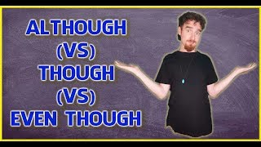
Food for thought
Even though VS although VS though

Slide 59
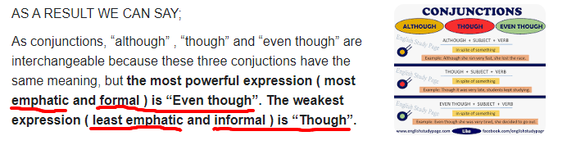
Food for thought
Even though (F, most emphatic)
Although (N)
Though (I, least emphatic)

Slide 60
Subordinating Conjunctions
3. Comparison
Just as
Whereas
In contrast to
While (*)
E.g:
I will succeed whereas you will fail.
the day began cold and blustery, in contrast to almost two weeks of uninterrupted sunshine.

Slide 61
Practice p.37
1-While camping in the mountains or on beaches is not very expensive, you must first buy a lot of essential equipment.
-> Although camping in the mountains or on beaches is not very expensive, you must first buy a lot of essential equipment.
Or
Camping in the mountains or on beaches is not very expensive. However, you must first buy a lot of essential equipment.

Slide 62
Subordinating Conjunctions
4. Cause
As
Because
Since
In order that
So that
E.g:
Can we work things (out) so that there's always someone here to answer the phone during office hours?

Slide 63
Food for thought
In order that VS so that

Slide 64
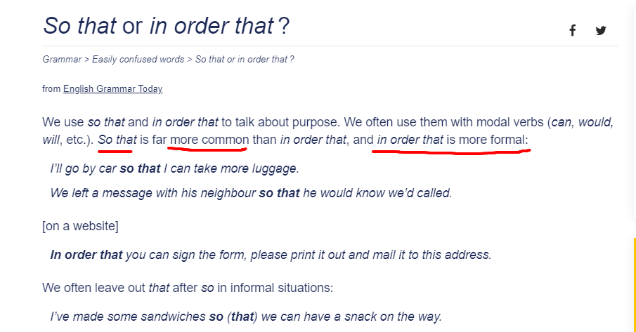
Food for thought
=> In order that (F) VS so that (N, more common)

Slide 65
Food for thought
So VS So that
1. “SO THAT”
“so that “ AS A CONJUNCTION ( ACTION – REASON/PURPOSE )
“so that”, as a conjunction, is used to make explanation about the clause or to express the reason or purpose of the clause. ( what purpose something is done )
Examples:
He wants to earn lots of money so that he can buy many things that he wants.
I put my glasses on so that I could see the movie better.
His father gave him some story books so that he could improve his reading.
ATTENTION:
“ that” can be omitted in an informal usage.

Slide 66
Food for thought
2. “SO”
“So” AS A CONJUNCTION ( SITUATION -RESULT/EFFECT)
“so”, as a conjunction, is used to connect two clauses. The clause which start with “so” introduces the result of the first clause.
( what happened as a result )
Examples:
They were tires, so they went to bed early.
I have some money, so I want to buy a new car.
He ran very fast, so we couldn’t see him exactly.

Slide 67
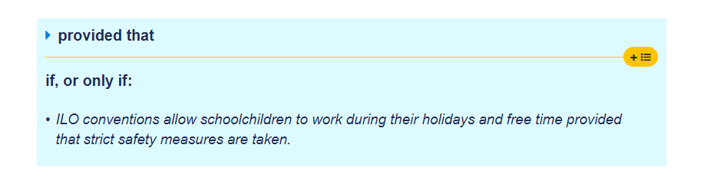
Subordinating Conjunctions
5. Condition
If
Even if
In case
Provided that
Unless
Until (*)
E.g:
Until we know what is causing the problem, we will not be able to fix it.

Slide 68
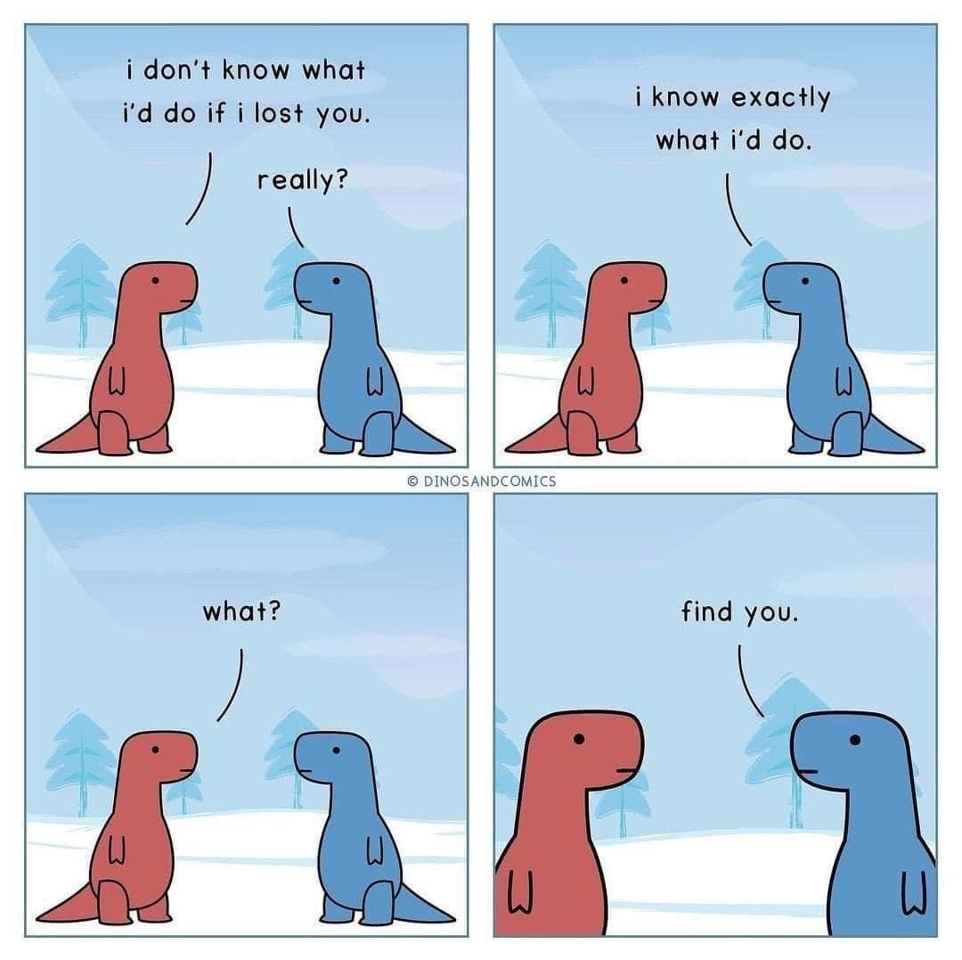
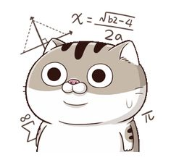
Food for thought – linearity revisit

Slide 69

Subordinating Conjunctions
6. Place
where
Wherever
whereas
Example:
Wherever she goes, I go.
I want to know the school (where) he goes to.

Slide 70
Relative clauses revisit
Dalat is the city where ….
Dalat is the city which ….
Dalat is the city whose ….
Sample answer:
Dalat is the city where our lovely writing teacher, Mr.Trung, was born
Dalat is the (only) city which I can call home.
Dalat is the city whose girls are gorgeous, bar none.

Slide 71
Food for thought
Dalat is the city where our lovely writing teacher, Mr.Trung, was born
-> N->F
VS Dalat is the city our lovely writing teacher, Mr.Trung, was born
-> I->N
VS Dalat is the city which our lovely writing teacher, Mr.Trung, was born in
-> least F, awkward
VS Dalat is the city in which our lovely writing teacher, Mr.Trung, was born
-> most F

Slide 72
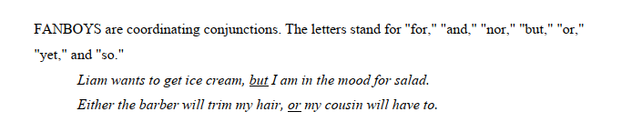
COORDINATING CONJUNCTIONS

Slide 73
Coordinating conjunctions (FANBOYS)
Independent Clause | Coordinating Conjunction | Independent Clause | Revised Sentence
I will not be attending the dance. | for (indicates a reason or cause) | I have no one to go with. | I will not be attending the dance, for I have no one to go with.
I plan to stay home. | and (joins two ideas) | I will complete an essay for class. | I plan to stay home, and I will complete an essay for class.
Jessie isn’t going to be at the dance. | nor (indicates a negative) | Harjot won’t be there either. | Jessie isn’t going to be at the dance, nor will Harjot be there.
The fundraisers are hoping for a record-breaking attendance. | but (indicates a contrast) | I don’t think many people are going. | The fundraisers are hoping for a record-breaking attendance, but I don’t think many people are going.
I might go to the next fundraising event. | or (offers an alternative) | I might donate some money to the cause. | I might go to the next fundraising event, or I might donate some money to the cause.
My parents are worried that I am antisocial. | yet (indicates a contrast) | I have many friends at school. | My parents are worried that I am antisocial, yet I have many friends at school.
Buying a new dress is expensive. | so (indicates a result) | By staying home, I will save money. | Buying a new dress is expensive, so by staying home I will save money.

Slide 74
Food for thought
She is beautiful and intelligent
-> She is not only beautiful but also intelligent?

Slide 75

Food for thought
Not only …. But also
VS
and

Slide 76
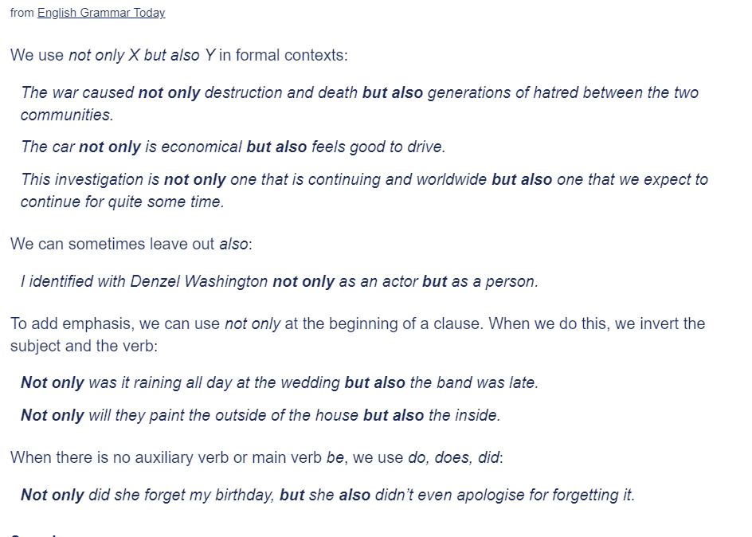

Not only but also

Slide 77
Not only but also
We use “not only … but also” when we have two things and we want to give a little extra emphasis to the second thing because it’s even better, or even worse, or more surprising, or more impressive, or more shocking than the first thing.

Slide 78
Inversion with not only …. But also
Increasing cost of fuel can not only save fuel, (but) it also protects environment.
→ Not only can increasing cost of fuel save fuel, (but) it also protects environment.
Video games are not only costly, they are also a waste of time
→ Not only are video games costly, they are also a waste of time.
Smoking doesn’t only harm your own health, it also threatens others
→ Not only does smoking harm your own health, it also threatens others.

Slide 79
Grammar drill
Sample clip – not only but also

Slide 80
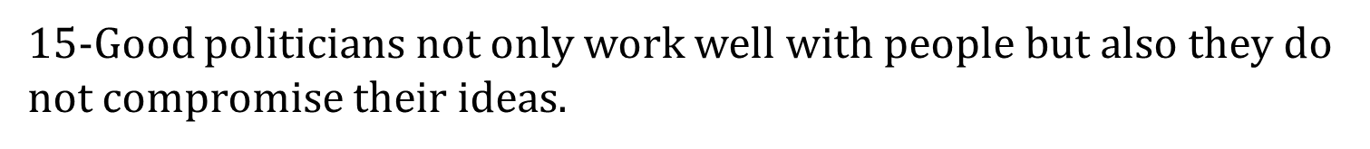
Exercise application
-> Jim has been outstanding not only in athletics, but also in his studies.
-> Not only in athletics has Jim been outstanding, but also in his studies (Inversion)
-> Good politicians not only work well with people but they also do not compromise their ideas.
-> Not only do good politicians work well with people, they also do not compromise their ideas.

Slide 81


Tuấn quê Hải
Phòng
a
em gặp Tuấn
b
nơi gặp nhau
khá tối
c
rồi Tuấn trúng số
d
mua được xe Mẹc
e
thường dùng Mẹc chở bạn bè đi chơi
f
em quyết lấy Tuấn
g

Slide 82



Tuấn quê Hải
Phòng
a
em gặp Tuấn
B
nơi gặp nhau
khá tối
c
rồi Tuấn trúng số
D
mua được xe Mẹc
e
thường dùng Mẹc chở bạn bè đi chơi
f
em quyết lấy Tuấn
G

Slide 83





Tuấn quê Hải
Phòng
a
em gặp Tuấn
B
nơi gặp nhau
khá tối
c
rồi Tuấn trúng số
D
mua được xe Mẹc
e
thường dùng Mẹc chở bạn bè đi chơi
f
em quyết lấy
G
Tuấn

Slide 84
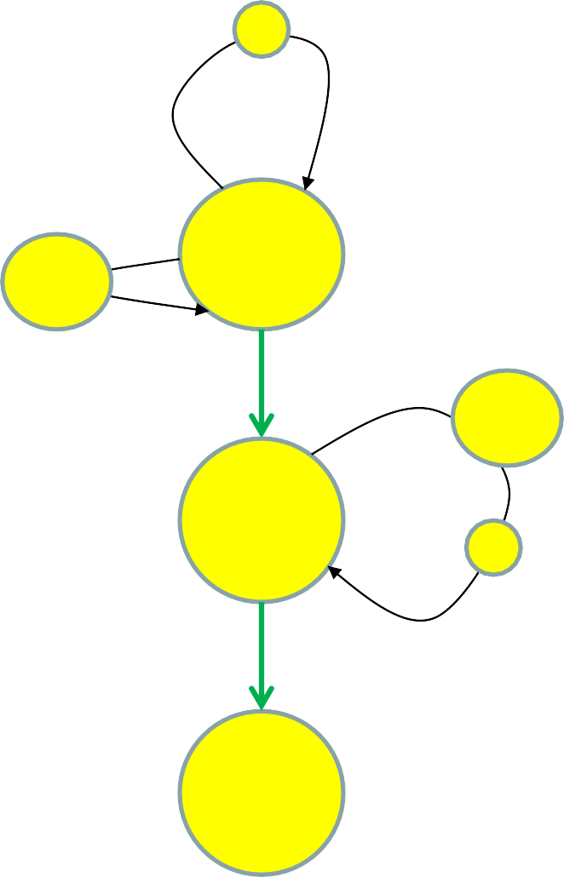
Tuấn quê Hải
Phòng
a
em gặp Tuấn
B
a
nơi gặp nhau
khá tối
c
downgrading
rồi Tuấn trúng số
B
D
c
mua được xe Mẹc
e
e
D
f
thường dùng Mẹc chở bạn bè đi chơi
f
em quyết lấy Tuấn
G
G

Slide 85
Tuấn quê Hải
Phòng
a
em gặp Tuấn
B
a
Em gặp Tuấn, người quê ở Hải Phòng,
ở một nơi mà khá tối
c
nơi gặp nhau
khá tối
c
rồi Tuấn trúng số
B
D
Rồi Tuấn trúng số
một phần khoản đó mua Mẹc mà dùng chở bạn bè đi chơi
e
mua được xe Mẹc
e
D
f
thường dùng Mẹc chở bạn bè đi chơi
f
Em quyết lấy Tuấn
em quyết lấy Tuấn
G
G

Slide 86

FOOD FOR THOUGHT
Tuấn quê Hải
Phòng
a
?
số Tuấn quá may
em gặp Tuấn
B
n
a
nơi gặp nhau
khá tối
c
rồi Tuấn trúng số
B
D
c
mua được xe Mẹc
e
e
D
f
thường dùng Mẹc chở bạn bè đi chơi
f
em quyết lấy Tuấn
G
G

Slide 87
DEPENDENCY & DOWNGRADING
I’ve done thorough research, and all I could find is…
vs. I’ve done thorough research, through which all I could find is…
vs. Having done thorough research, all I could find is…
– vs. All I could find, having done thorough research [embedded], is…

Slide 88
DEPENDENCY & DOWNGRADING
I was surprised that this is from a Pulitzer Prize winner and a Stanford professor.
[ambiguity: one person or two?]
vs. I was surprised that this is from a Stanford professor, who won a Pulitzer.
vs. I was surprised that this is from a Pulitzer winner, who is also
[sub + AMPLIFICATION] a Stanford professor.
vs. This is from ─ it came as a surprise to me [embedded] ─ a Pulitzer winner, who is also [sub + AMPLIFICATION] a Stanford professor.

Slide 89
Exercise application
2-The lift chairs were going around very fast. They were bumping the skiers into their seats.
-> The lift chairs, which were going around very fast, were bumping the skiers into their seats. (emphasize event)
VS The lift chairs, which were bumping the skiers into their seats, were going around very fast. (emphasize speed)
VS The lift chairs were were going around so fast that they were bumping the skiers into their seats. (cause-effect)

Slide 90

Exercise application
6-The Market Inn is located at 2nd and E Streets. It doesn’t look very impressive from the outside. The food, however, is excellent.
-> The Market Inn, which doesn’t look very impressive from the outside, is located at 2nd and E Streets. The food, however, is excellent.
VS The Market Inn, which is located at 2nd and E Streets, doesn’t look very impressive from the outside. The food, however, is excellent.
6’ -The Market Inn is located at 2nd and E Streets. It doesn’t look very impressive from the outside.
-> The Market Inn, which doesn’t look very impressive from the outside, is located at 2nd and E Streets. (emphasize location)
VS The Market Inn, which is located at 2nd and E Streets, doesn’t look very impressive from the outside. (emphasize appearance)
=>> Linking importance

Slide 91
Fun activity
Sample clip – Phoebe’s non-linearity

Slide 92
FOOD FOR THOUGHT
Chúng tôi lựa chọn và đầu tư vào các doanh nghiệp Việt Nam

Slide 93
FOOD FOR THOUGHT
Chúng tôi lựa chọn và đầu tư vào các doanh nghiệp Việt Nam
We selectively invest in Vietnamese businesses
select and invest vs. selectively invest
2-verb sequence in Vietnamese → adverb + verb in English
cười và chấp nhận (lời mời)

Slide 94
FOOD FOR THOUGHT
Chúng tôi lựa chọn và đầu tư vào các doanh nghiệp Việt Nam
We selectively invest in Vietnamese businesses
select and invest vs. selectively invest
2-verb sequence in Vietnamese → adverb + verb in English
cười và chấp nhận (lời mời)
smilingly accept (the invitation)
gạt nước mắt mà đi
weepingly leave
gào thét để phản đối
screamingly protest
biết mà vẫn vi phạm (luật)
knowingly violate (the law)
Fun questions: nhắm mắt và hôn vs. bịt mũi mà hôn

Slide 95
COMBINATION TECHNIQUES
My girlfriend is angry. I can't go out.
Use an explicit linking item
Since My girlfriend is angry, I can't go out. [conj]
My girlfriend is angry, [and] therefore I can't go out. [adv]
With My girlfriend is angry, I can't go out. [prep]
My girlfriend is angry, which is a reason why I can't go out.
[relative pronoun]
My girlfriend is angry; I can't go out. [semicolon as a textual Theme]
Use no explicit linking items: absolute clause [F, O, L]
My girlfriend being angry, I can't go out.

Slide 96
ABSOLUTE CLAUSE
Use no linking items:
My girlfriend being angry, I can't go out.
reduced adverbial clause main
implicit linking
His voice trembling, he told his story. [marked]
His money wasted on gambling, he has nothing left. [marked]
He stood before me, his hands [being] in his pockets.
[unmarked]
Notes on reduction rules:
My girlfriend being angry, I can't go out.
– My girlfriend angry | incredibly angry | angrier than ever, I can't go out.

Slide 97



THANK YOU

